Slide 1

Project XLR8: Designing E2E Azure AI Solutions
Jonathan Vella, Microsoft
Rodanthi Alexiou, Microsoft
May 2025

Slide 2
Why did we create this workshop
We need to accelerate the safe adoption of AI
We must build AI solutions which go beyond models
We must responsibly control generative AI outputs

Slide 3
What will you learn
How to navigate the full AI journey from ideation to production.
How to design and implement secure, scalable, and well-governed AI solutions from start to finish.
How to architect, build & operate cost effective trustworthy AI solutions.

Slide 4
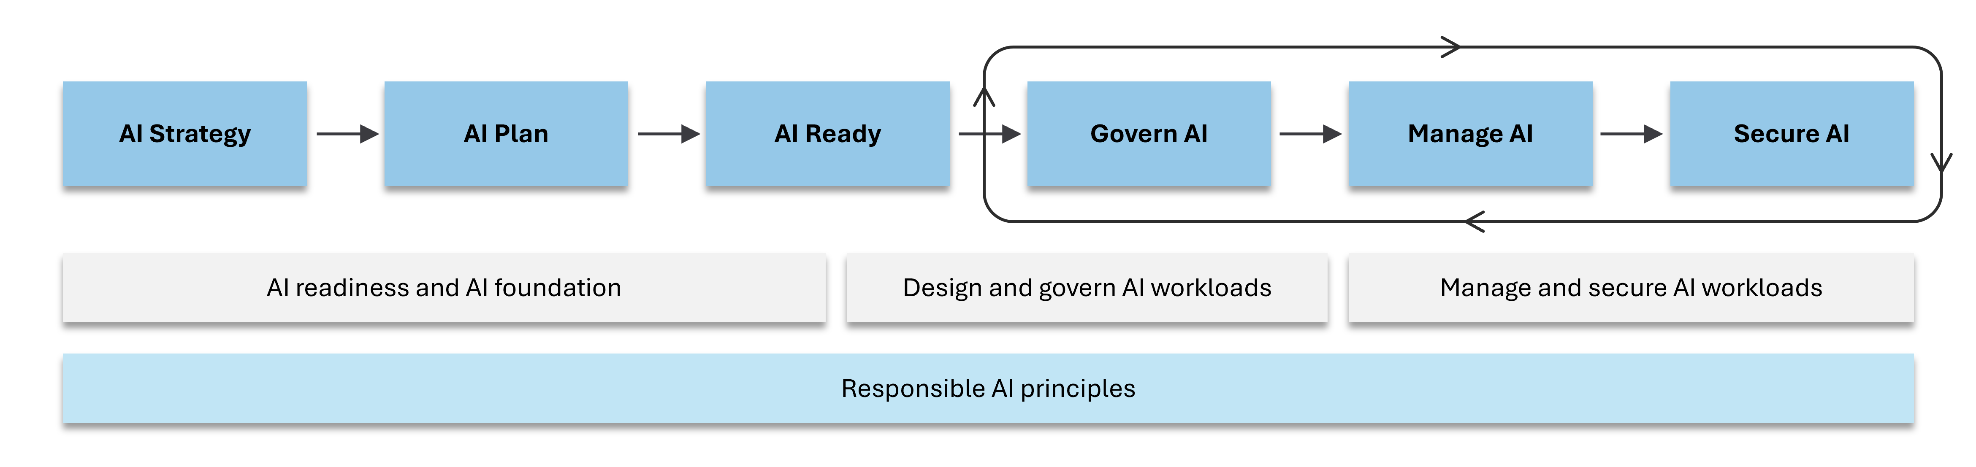
The AI Adoption Process

Slide 5
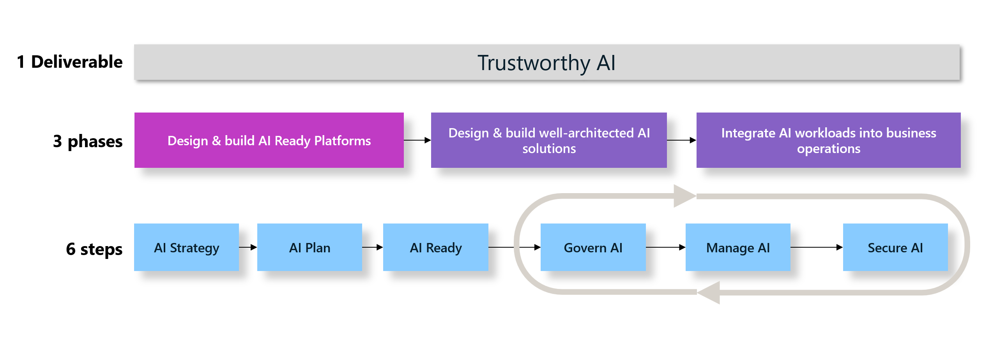
Objective: Trustworthy AI

Slide 6
Scenario: IFS AI Transformation
Who: Innovate Financial Services (IFS), a leading financial institution, is undergoing an AI-driven transformation to stay competitive against fintech disruptors.
What: Their strategy focuses on leveraging AI for fraud detection, personalized financial advice, risk management, and automated customer support.
Why: They face challenges such as fragmented data, infrastructure complexity, security compliance, and slow innovation cycles. By adopting Azure’s AI services, IFS aims to integrate AI into core business processes, enhance security, and accelerate innovation.
How: Their success will be measured by reductions in fraud, improved customer satisfaction, and lower operational cost.

Slide 7
Workshop Overview
Part 1: Develop an AI strategy and establish an AI foundation.
Part 2: Design production-ready AI workloads
Part 3: Scale and evolve AI solutions

Slide 8
P1: AI Strategy & AI Ready Platform
Identify requirements and translate them into viable AI use cases.
Define clear, measurable business and technical success criteria.
Design an AI ready platform which is secure, scalable, and well-managed from day one.

Slide 9
P2: Production-Ready GenAI
Identify functional & non-functional requirements.
Design a GenAI on Azure architecture.
Operationalize the GenAI workload.

Slide 10
P3: Scale AI workloads
Move beyond isolated projects and scale AI across the organization.
Design an architecture which is based on shared services, and reusable components.
Architect a controlled gateway for accessing services, enforcing strict security and governance.

Slide 11
Key Takeaways
You will understand the full lifecycle of an AI solution, not just the model building.
You will learn how to embed security, scalability, and governance from the initial design phase.
Learn about strategies for designing AI workloads that are production-ready.
Gain insights into integrating solutions effectively within a secure and governed environment.
A framework for thinking about reusable AI components and scaling.

Slide 12
Target Audience
Data Scientists
Data Engineers
Solution Architects
DevOps/MLOps Engineers
Anyone involved in bringing AI/ML projects to production.
Security Engineers

